Slide 1
🌡️Temperature Check Part Deux🌡️

Slide 2
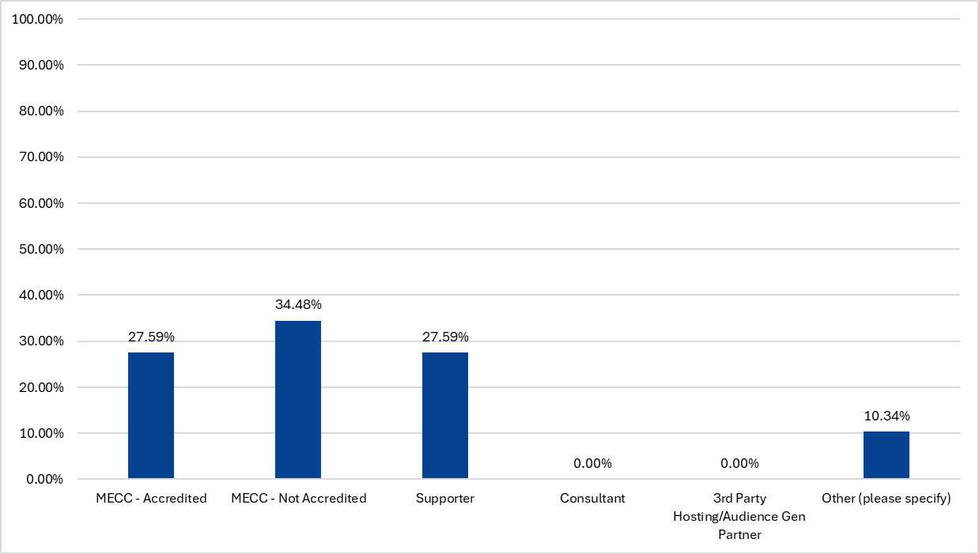
I am a:
n = 29

Slide 3
Other:
Academic Institution - Accredited
HPMS
Academic center accredited

Slide 4
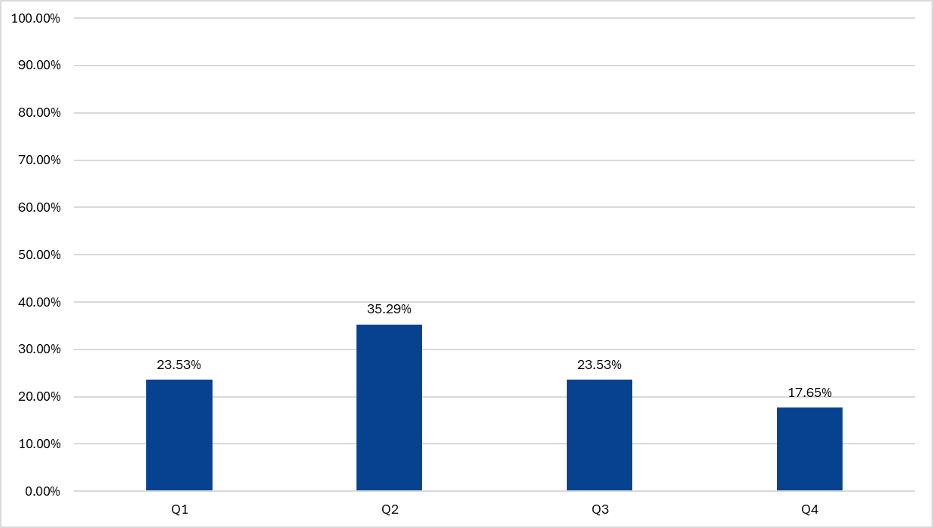
What time of the year do you see the majority of grant approvals?
n = 17

Slide 5
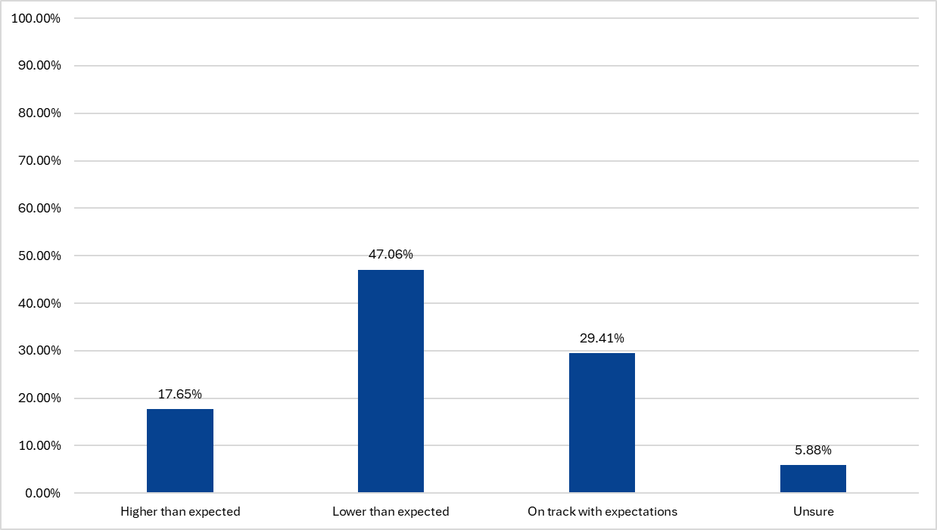
Compared to Q3 2024 grant support awarded for my organization is:
n = 17

Slide 6
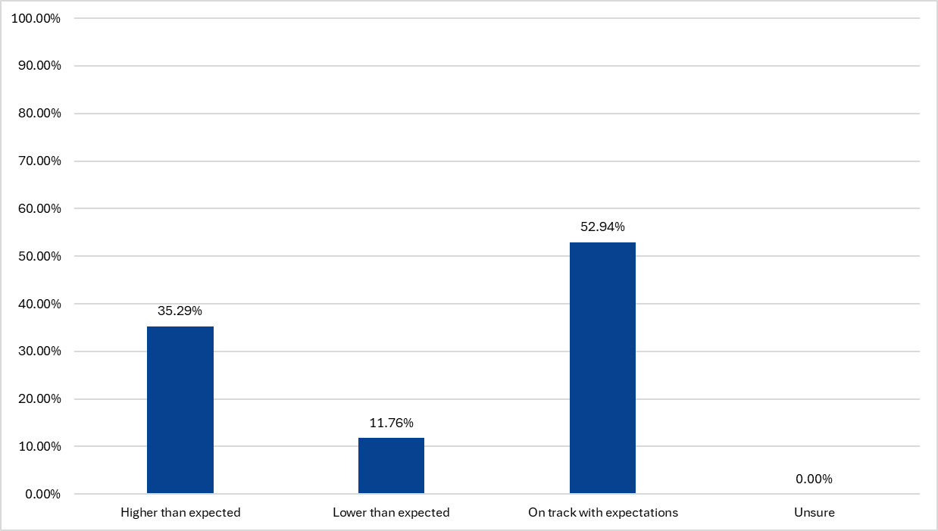
Compared to Q3 2024 grant support declined for my organization is:
n = 16

Slide 7
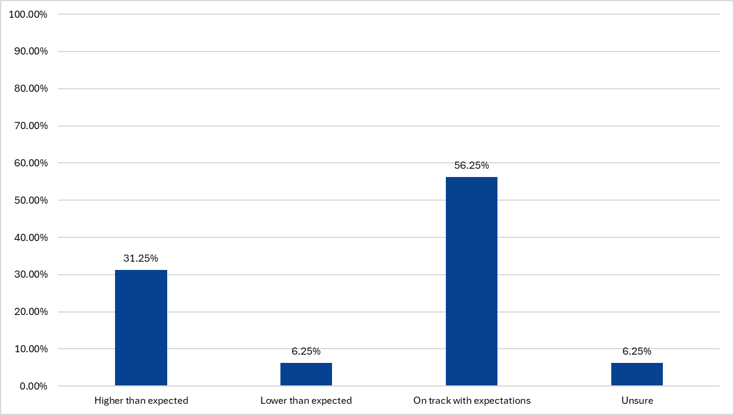
Compared to Q3 2024 grant support pending a decision for my organization is:
n = 16

Slide 8
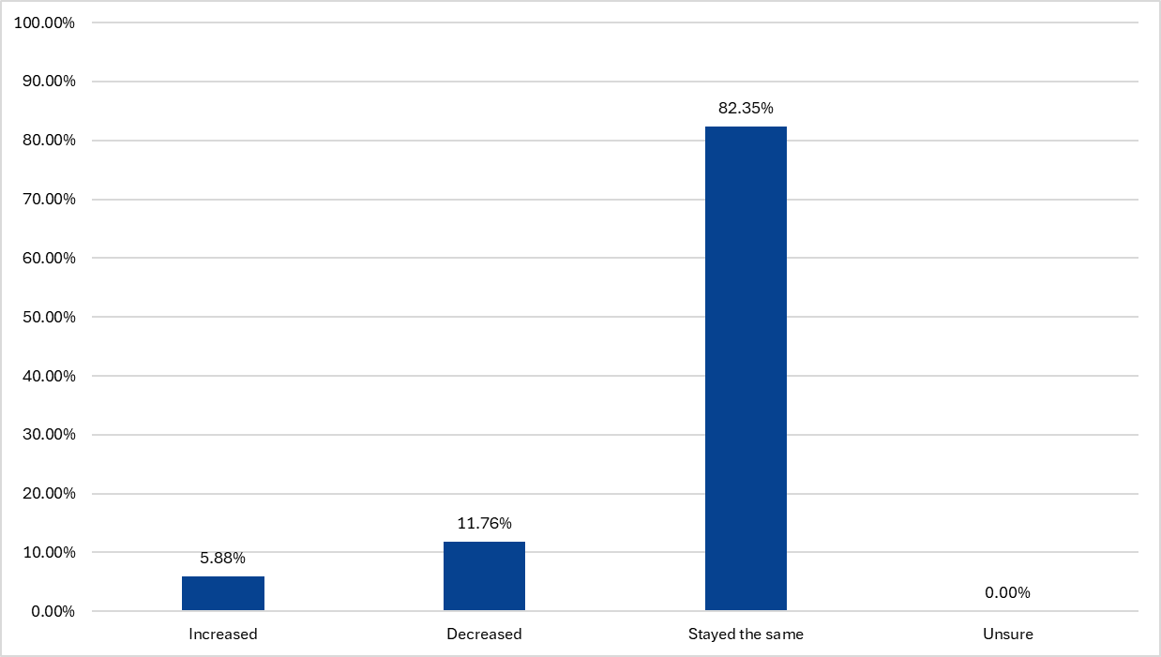
Staff for my department has:
n = 17

Slide 9
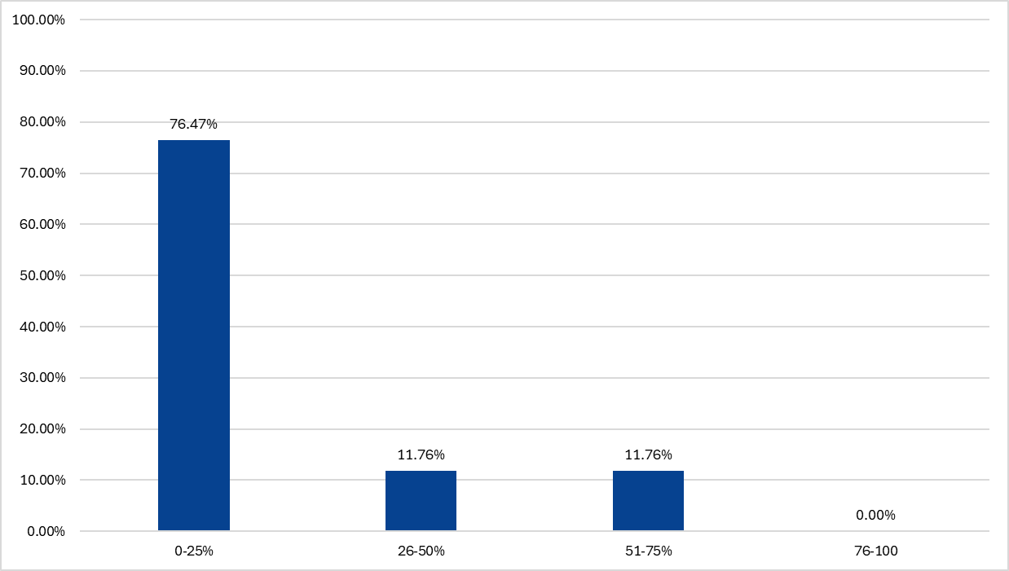
Approximately how many of your activities are multi-supported (two or more grantors)?
n = 17

Slide 10
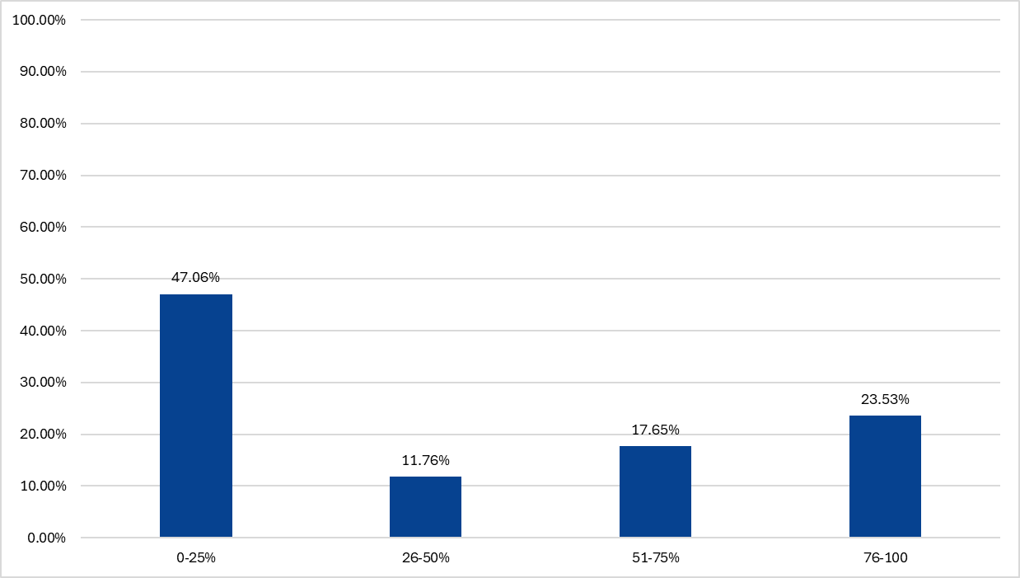
Approximately how many of your activities end up as sole supported as a result of a COS (one grantor)?
n = 17

Slide 11
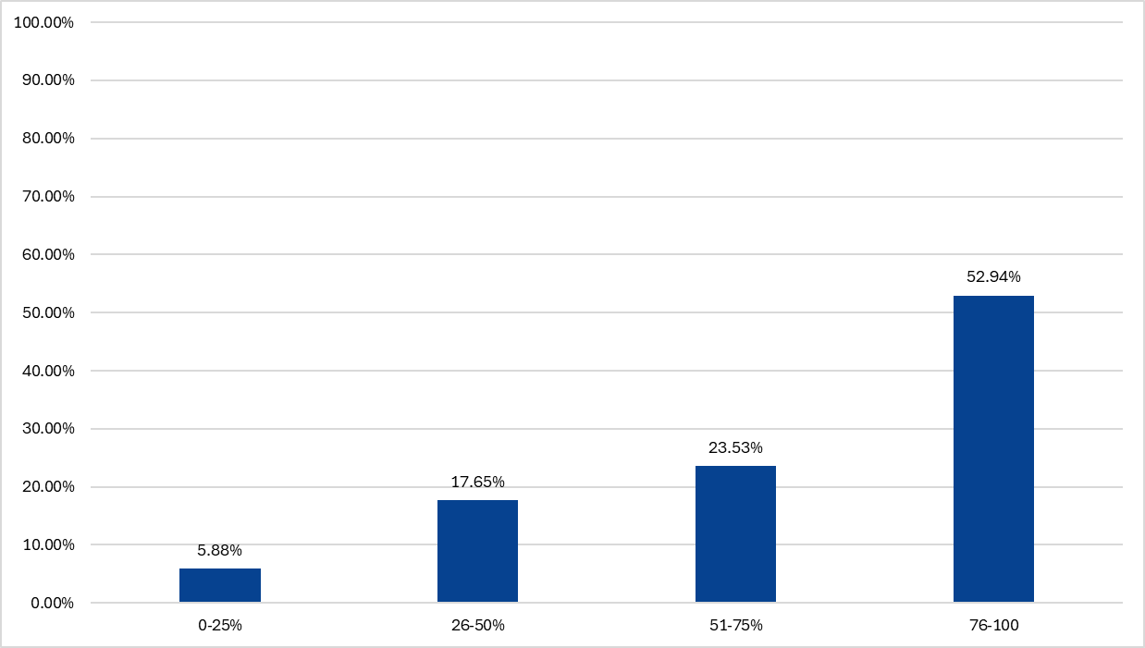
Approximately how many of your activities are planned as sole supported (one grantor)?
n = 17

Slide 12
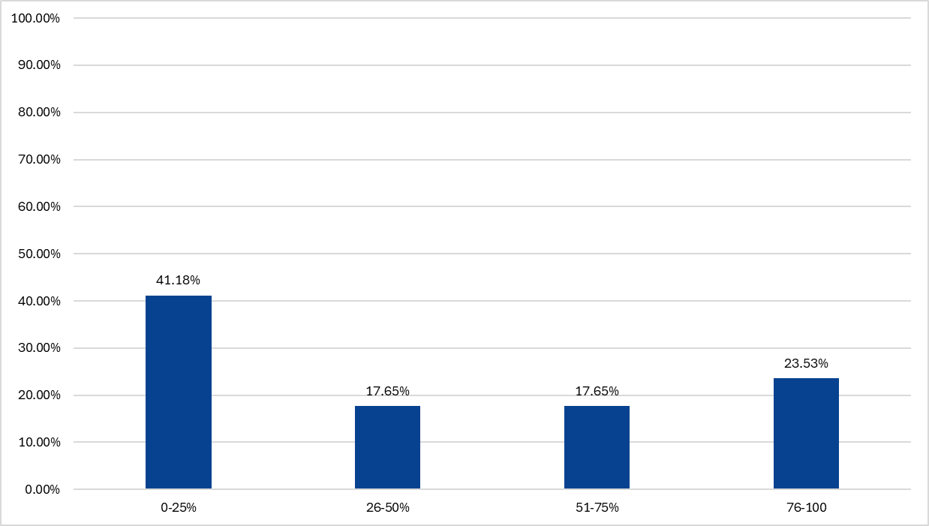
What percentage of your programs have a variable start date?
n = 17

Slide 13
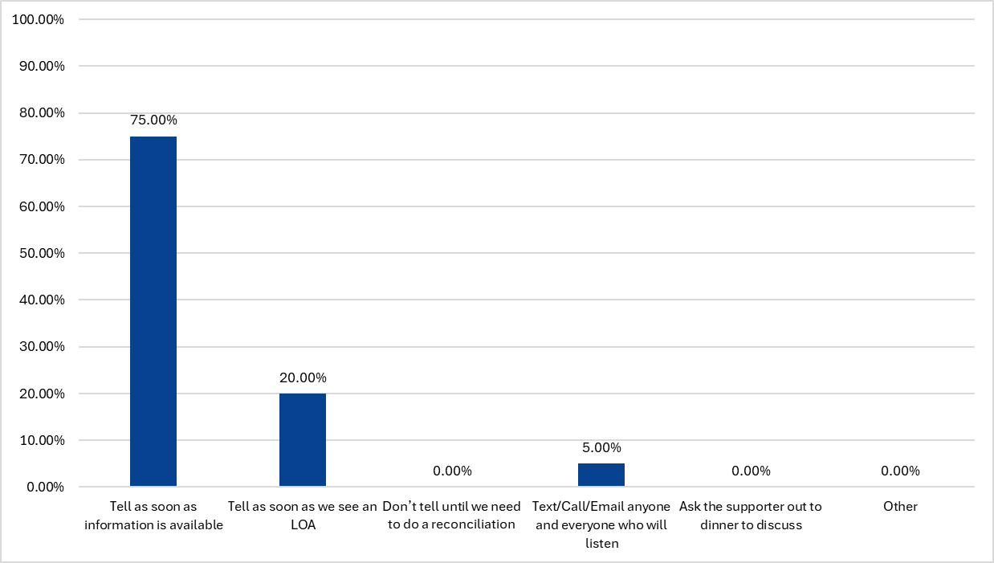
How do you communicate updates on multi-support or date variability? (Select all that apply)
n = 20

Slide 14
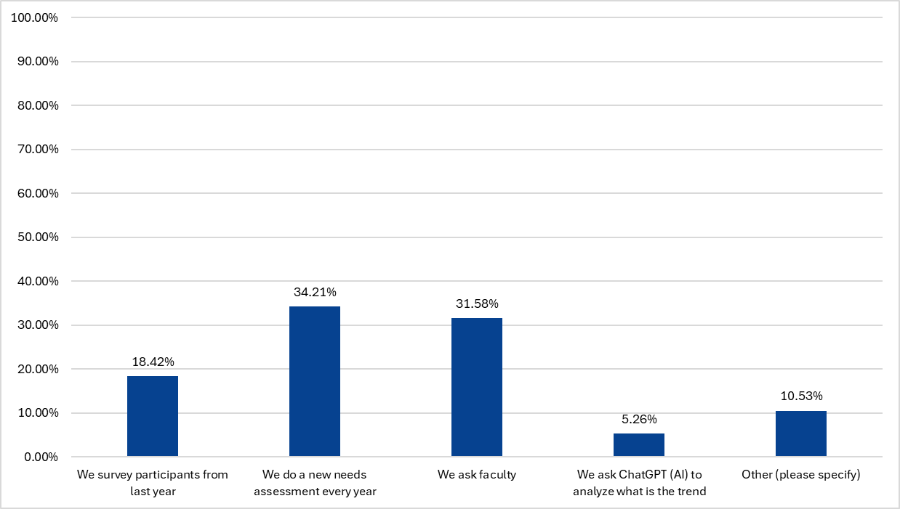
How do you ensure your activities are moving the education forward? (select all that apply)
n = 38

Slide 15
Other:
Outcomes analysis at the end of each activity
Needs assessment every 2 years
We review and compare course participant evaluations.

Slide 16
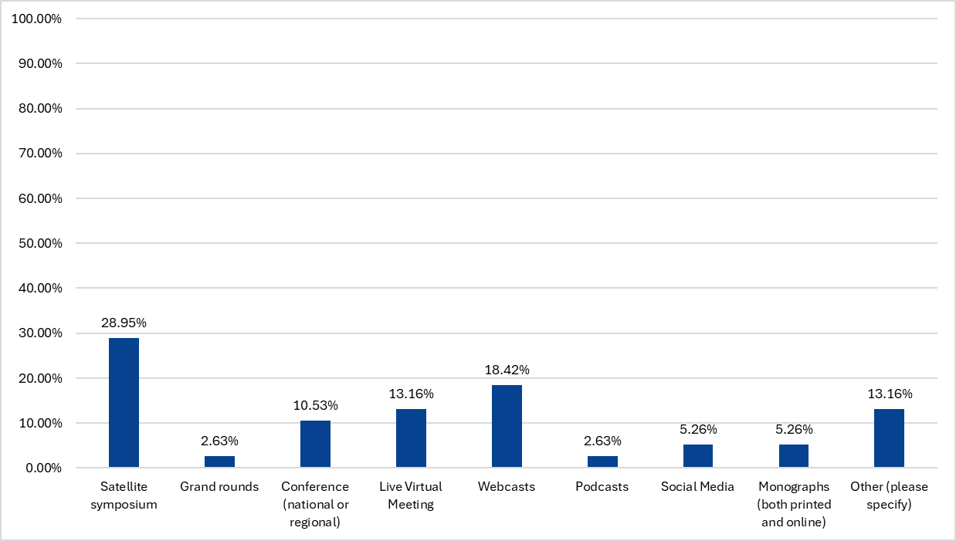
The majority of grant support dollars awarded to my organization supports (select all that apply):
n = 38

Slide 17
Other:
Online CME activities
Online enduring programs
Interactive on-demand activities
Live courses with hands on labs
Ai

Slide 18
Supporter Questions

Slide 19
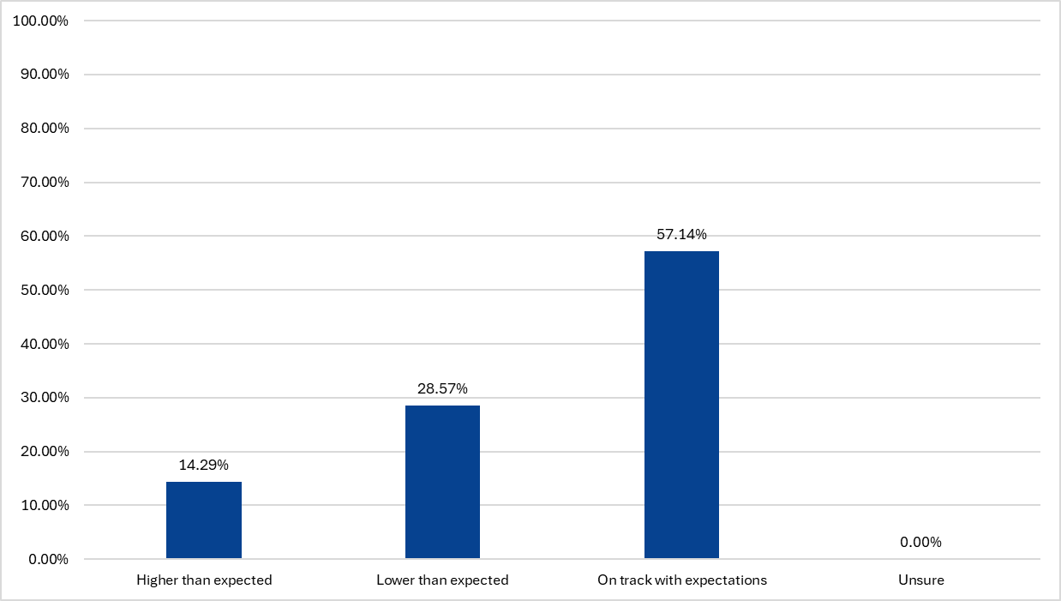
Compared to 2024 the IME budget for my organization is:
n = 7

Slide 20
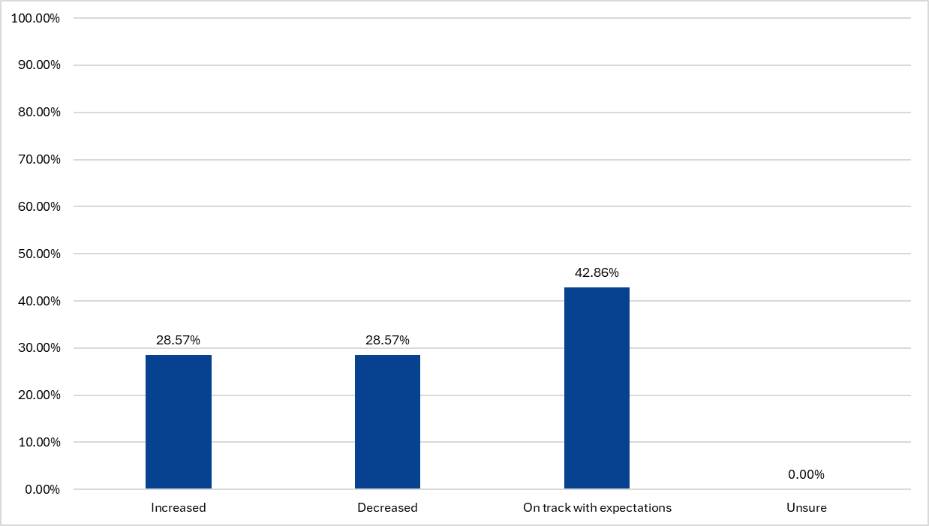
In the last 6 months, my IME budget has:
n = 7

Slide 21
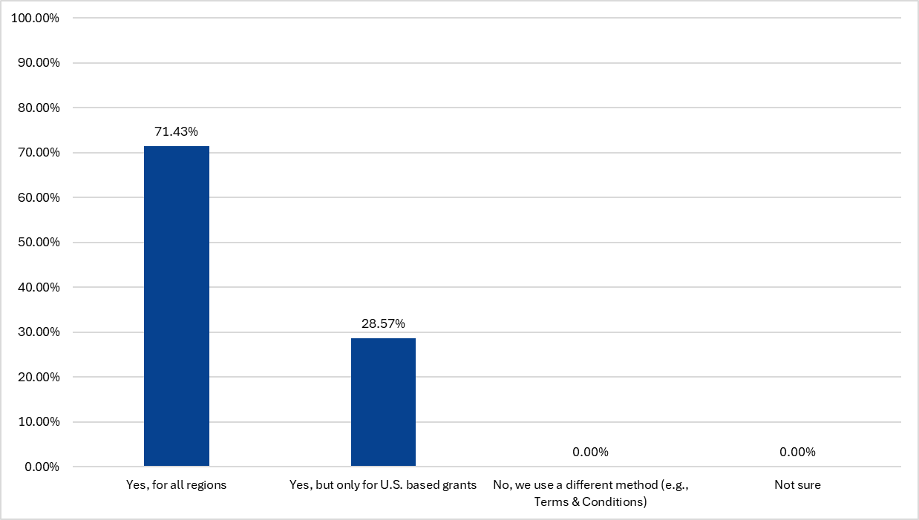
Do you currently require a legal contract for all grants? (Select one)
n = 7

Slide 22
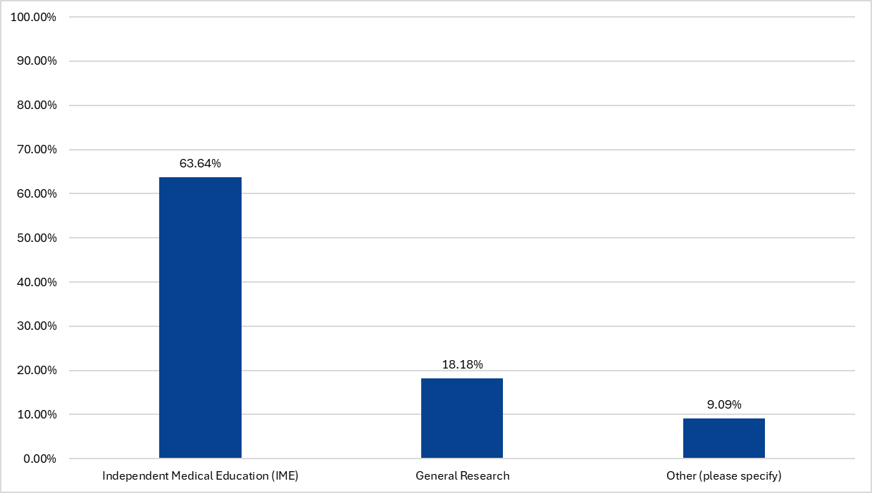
If Yes to the above question: For which types of grants do you typically require a contract?
n = 11

Slide 23
Other:
Medical Writing and Sponsorships

Slide 24
2024 → 2025 Comparison

Slide 25
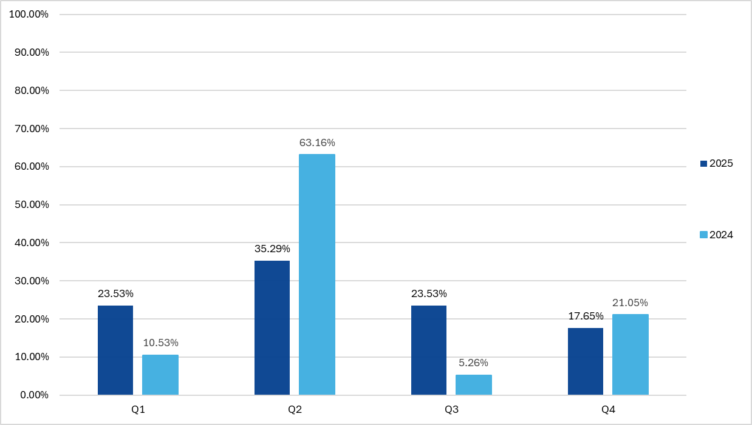
What time of the year do you see the majority of grant approvals?
n = 17
n = 19

Slide 26
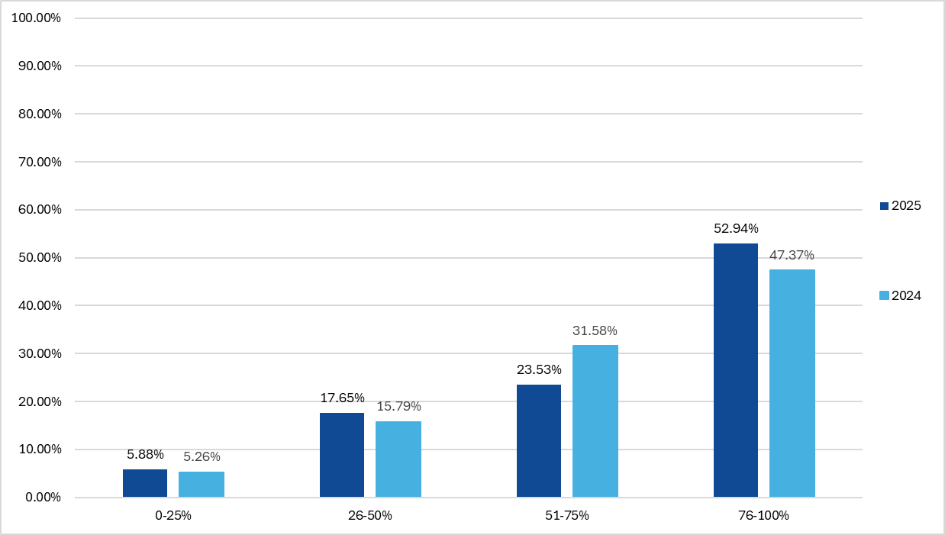
How many of your activities are sole supported (one grantor)?
n = 17
n = 19

Slide 27
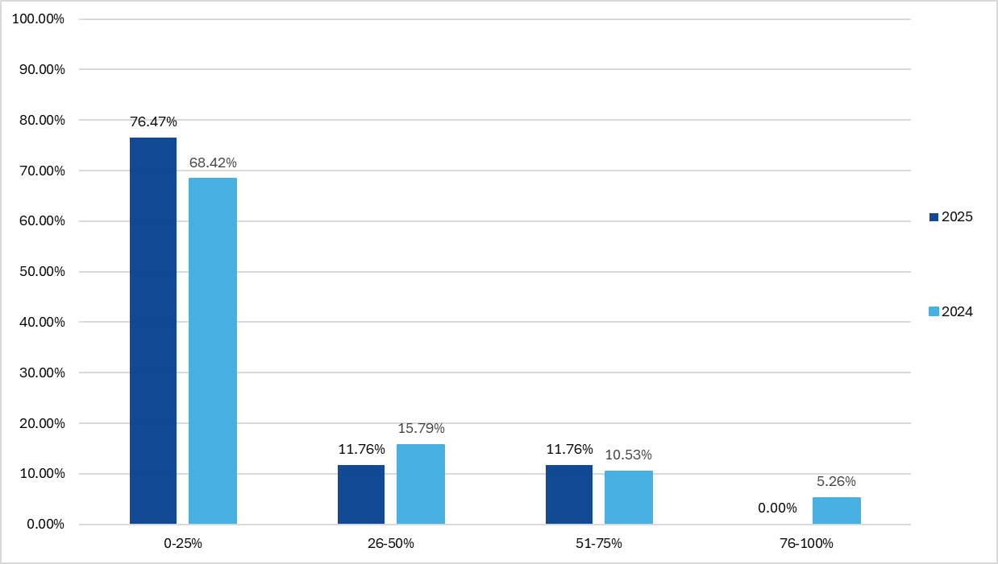
How many of your activities are multi-supported (two or more grantors)?
n = 38
n = 48

Slide 28
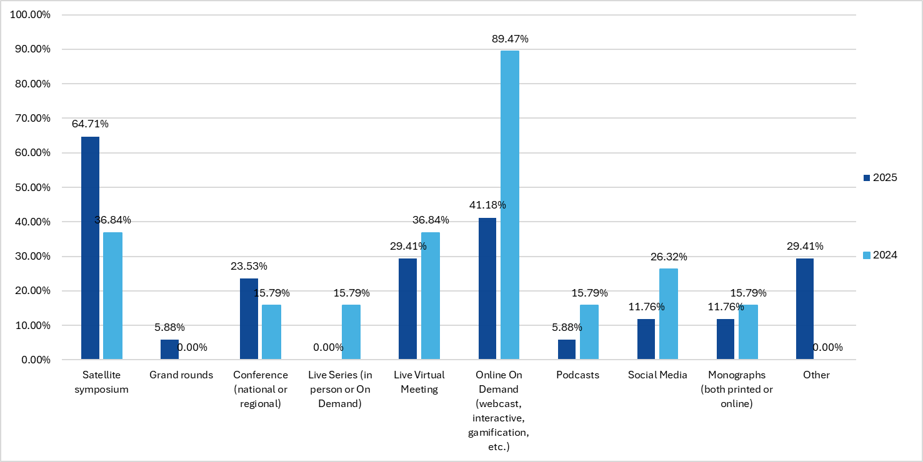
The majority of grant support awarded to my organization supports (select all that apply):

Slide 29
Thank you!
Questions? Comments?
Please contact: afunk@globaleducationgroup.com

